Slide 1

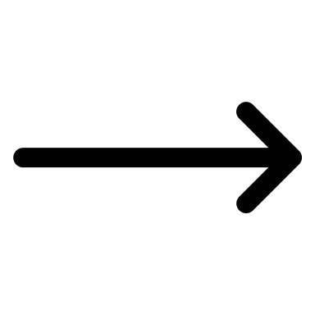
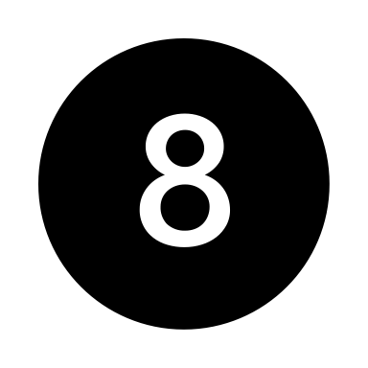
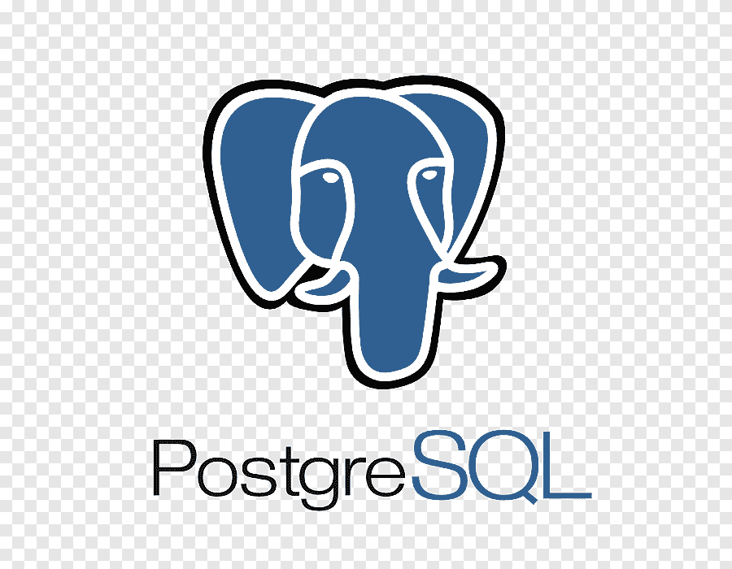
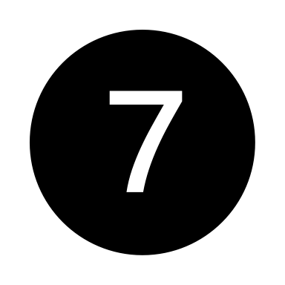

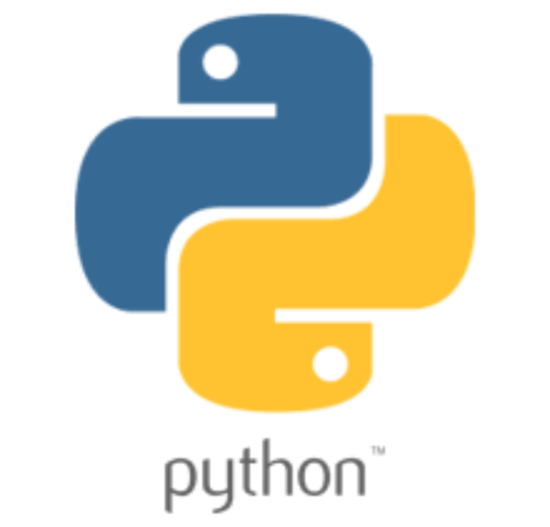

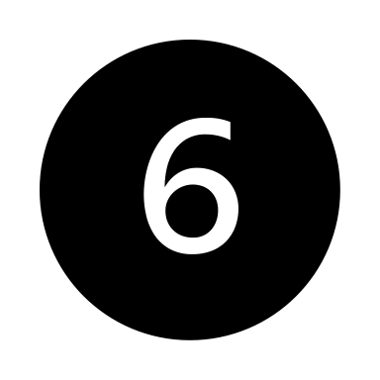
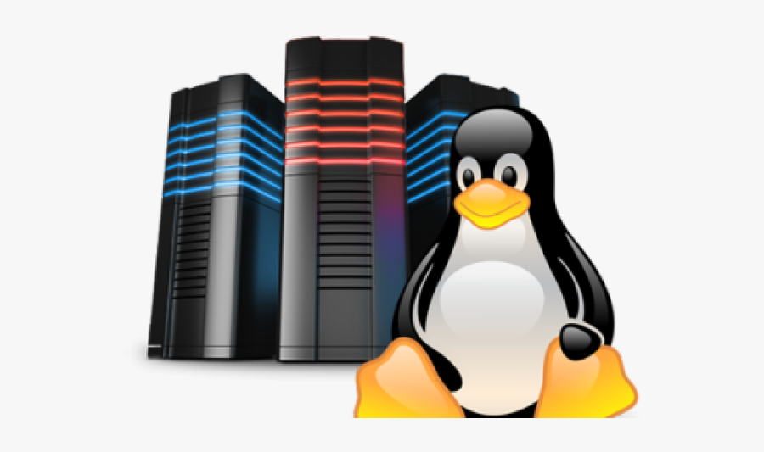
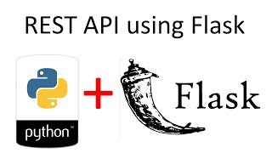
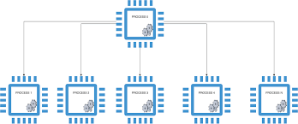

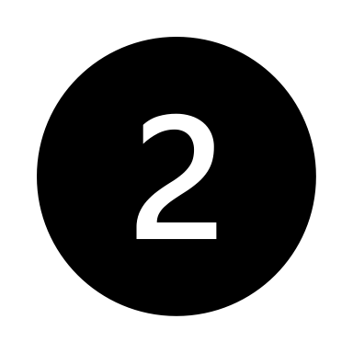
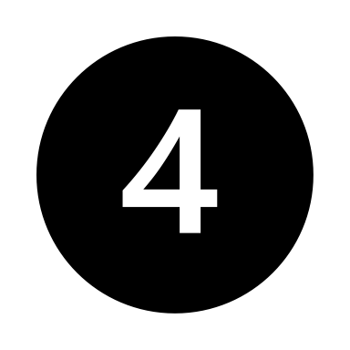
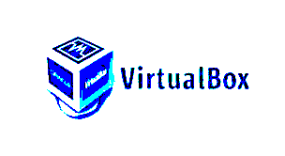
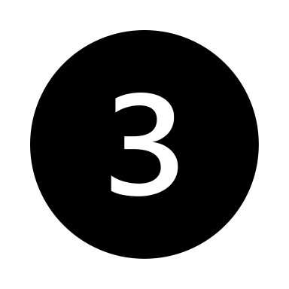
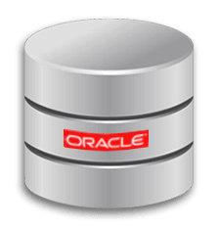
Hits /atoll/coverage_status with request_id
Queries the npp database and gets the coverage details
Reads the docs and fetches the predictions and updates the record with SUCCESS status
Coverage.run()
Creates the docs and adds values to docs, calculate_coverage()
Ex:/atoll/coverage_request
Coverage.py
User hits the flask api call with post json(payload)
Calls the receive_from_vmb – receives the consumer message.Updates the record with PROCESSING_ATOLL
Returns the request_id
Calculates the coverage data
NPPCoverages database
Multiprocessing
Rest.py sends the messages to vmb(calls add_to_vmb function - connects to the product_name and creates a token for producer) and updates the record with status ADDED_TO_QUEUE
Queries the NDL database
NPPCoverages database
Ondemand.py
NPP writer database
Triggers Rest.py
Extracts the dataframe values and inserts into NPP coverage database
Updates the record with status “SENT TO ATOLL/SENT TO ATOLL TEST”
Queries the NPP database with status “SENT TO ATOLL / FAILURE”
If error updates the record status with Failure
Windows boxes where ondemand.py is running

